Slide 1

93 Jones Avenue Brakpan
( 011 ) 740-0644 P
( 011 ) 740-2784 F
082 – 444 – 8623
082 – 416 – 7249
www.ajgerdhydraulics.co.za
Marketing Portfolio

Slide 2

Introduction
We wish to take this opportunity to introduce our company and invite you to visit our workshop at 93 Jones Ave , Vulcania , Brakpan for assessment.
We do from “ PISPOT “ tot n “ DUIKBOOT

Slide 3
Mission Statement
Mission: The mission of A.J.Gerd Hydraulics & Engineering is to be the best in the repair of all Hydraulic Equipment and service the industry with passion and loyalty.
We saw a gap in the market place for still repairing hydraulic Pumps and Motors where the opposition was more in replacing NEW mindset . Only in worse case scenario and we cannot source the spares to repair your unit we will replace .

Slide 4
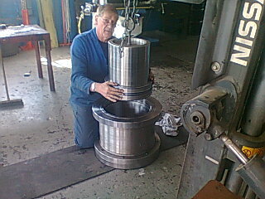
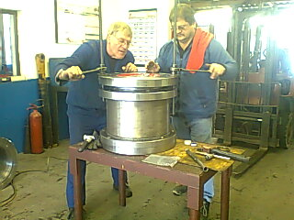
Our line of business is the repair and supply of hydraulic pumps and motors including spares.
We also repair and manufacture Hydraulic and Pneumatic Cylinders.

Slide 5
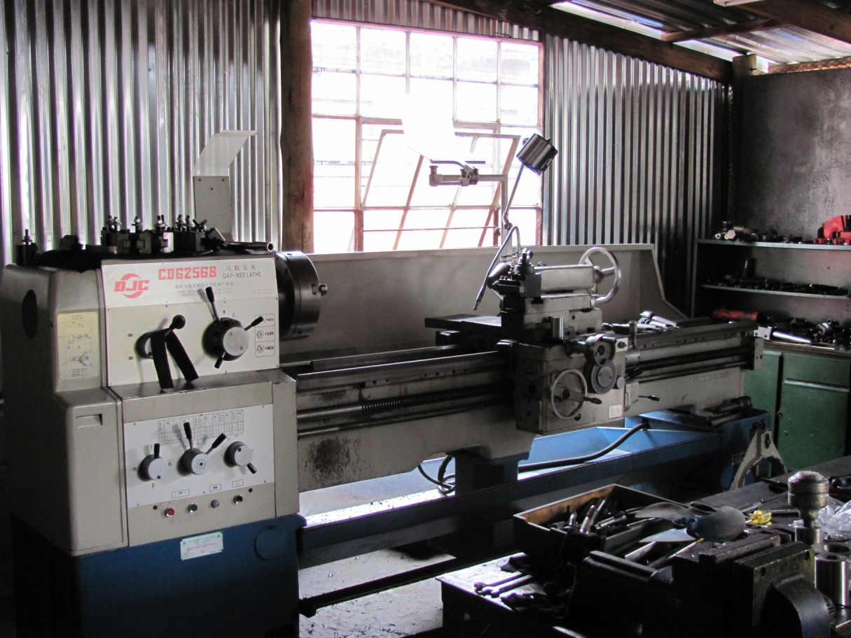
The designed erection of our modern workshop is a 350 M² large open floor plan. 320 m² engineering shop , 250 m² of dedicated hoses and fittings clean environment .
Our workshop is equipped with 2 by 2 meter lathe, 1 x 3 meter lathe ,CnC milling machine, 1 x 1 meter lathe external grinder .CnC lathe surface grinder, and a hydraulic test bench and stress beam, showing multiple flow, pressure, temperature, speed and torque readings.

Slide 6
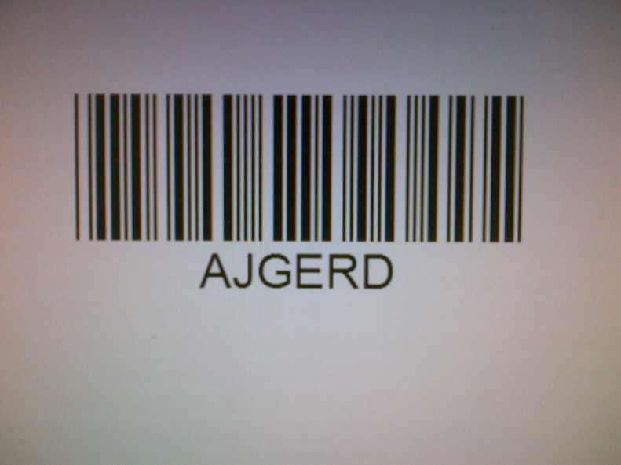
We have purpose designed computer software program, and unique barcode
to facilitate stock control, job costing and our financial system .
Our computer system, already has a quality management system installed, based on the requirements of SABS ISO 9002.

Slide 7
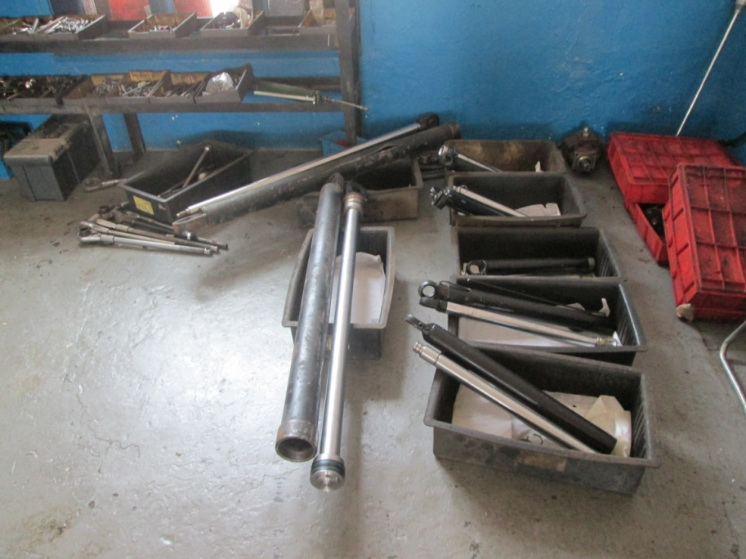
Our Job procedures is as follows:
  Cleaning Bay
  Stripping area
  Await for card Quote
  Awaiting Go Ahead
  Awaiting Assembly
  Awaiting Dispatch
Once the incoming job, has left the cleaning bay and has been entered on the computer, it proceeds to the stripping area for assessment.
The job is labelled with a number and stored in a designated area.

Slide 8
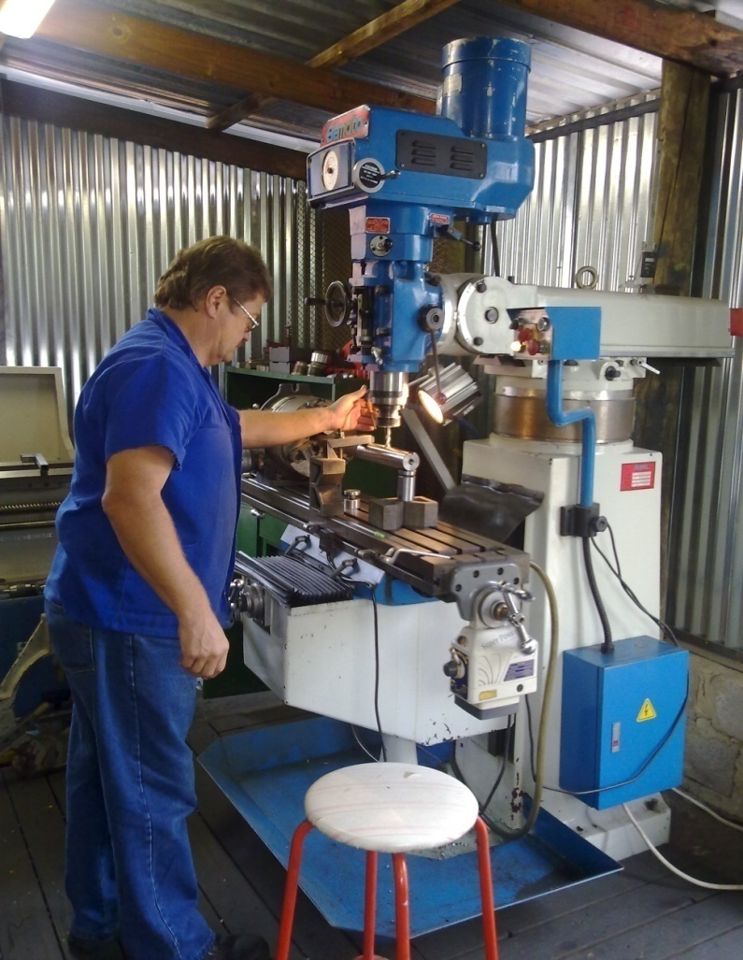
When the “go ahead” is received, appropriate spares are ordered for the work in progress to proceed to the assembly bay.
The unit gets re inspected with parts ordered and then assembled by qualified artisan .
The product is then tested and certified, for the final inspection to be carried out.
The merchandise is then sprayed, with the correct colour, and sealed in plastic.

Slide 9
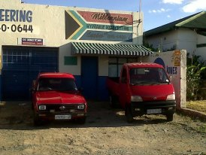
As we are a service industry, we collect and deliver all products.
  We hold spares and service exchanges for VICKERS, REXROTH, SUNSTRAND, COMMERCIAL AND KAWASAKI pumps.

Slide 10

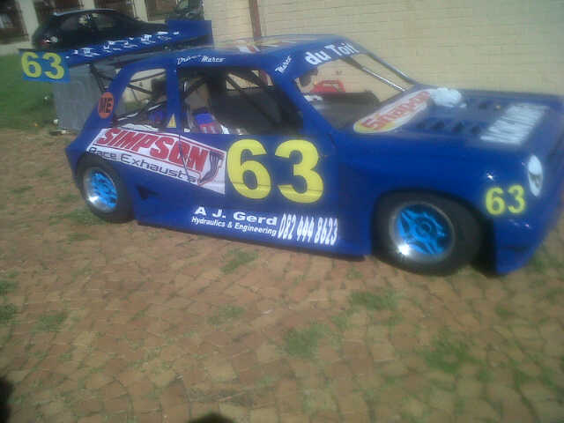
Community service
We at A.J. Gerd Hydraulics strives to support local communities
For well considered sponsors contact us 082-444-8623

Slide 11
The Team
Albert du Toit is the Owner.
Zelda Oliver in Product Support
Marco du Toit dedicated Sales Manager
Include previous accomplishments to show that these are people with a record of success.
We have 17 years of experience in these fields:
      Hydraulics
      Hoses and Fittings
      Engineering
      Pneumatics
      Hydraulic and Pneumatic seals and kits

Slide 12
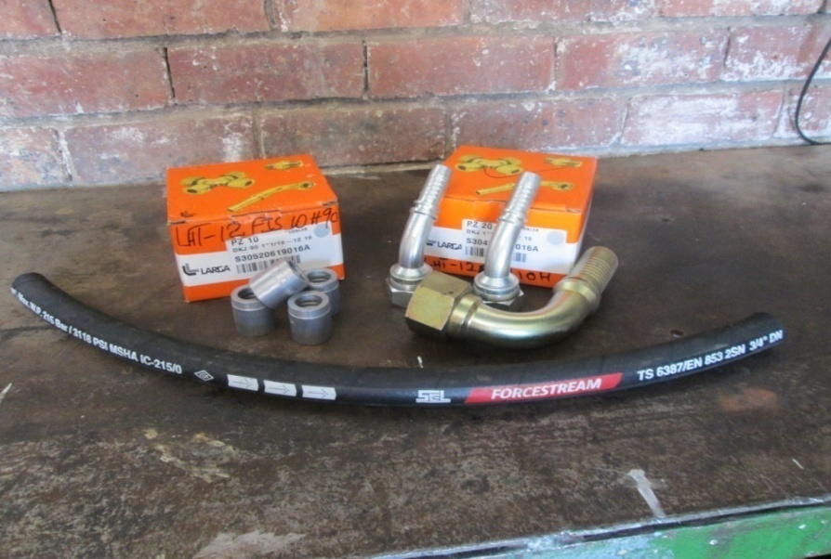
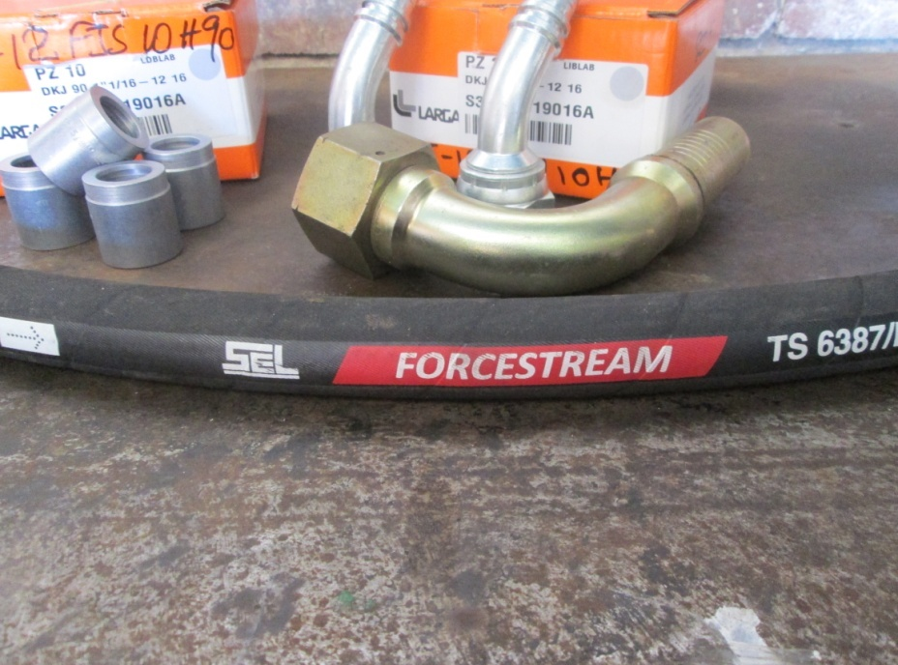
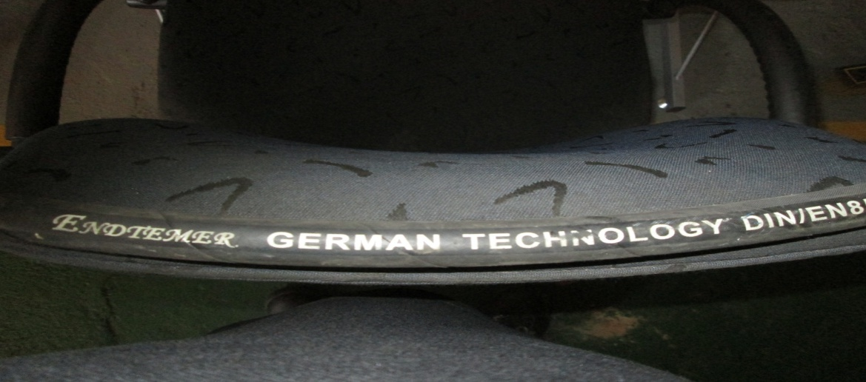
Product
We obtain hose from 2 reputable suppliers . SEL hose from Turkey
Endtemer from Germany
Specification available on request
The fittings and collers are directly imported from Larga in Italy

Slide 13

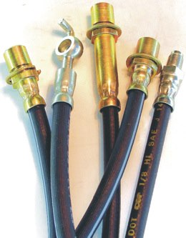
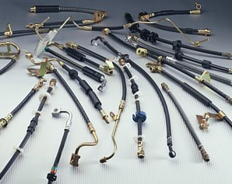
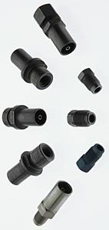
AGENTS FOR CEF BRAKEHOSE ASSEMBLY

Slide 14

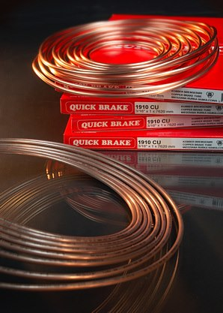

QUICK BRAKE ASSEMBLY

Slide 15

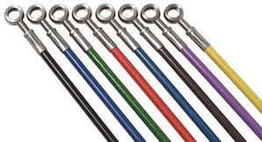
HELL COLOURED BRADED HOSE

Slide 16

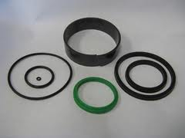

We stock and supply Hydraulic Seal kits for most Populer Earth Moving Machines

Slide 17
CUSTOMER BASE
Asatico ~ A.B. ~ ( 011 ) 740-7211
Bartlett Construction ~ Trevor ~ ( 011 ) 472-3633
Bredell Plant Hire ~ Rudolph ~ 082-557-5945
B.S.C. Stationeries ~ A.J. ~ ( 011 ) 086-2900
Conglo ~ Rudolph ~ ( 011 ) 072-373-3629
D.S.D. Technologies ~ Simon ~ ( 011 ) 740-9321
Getspares ~ Raymond ~ ( 011 ) 397-5276
J.J. Maritz ~ Mike ~ ( 011 ) 391-7381
K.H. Plant Hire ~ Klaus ~ ( 011 ) 786-2175
Kumbelo Brickworks ~ Kobus ~ 082-458-9615
Orhan ~ George ~ 082-457-0974
Parts Brokers ~ Morne ~ ( 011 ) 421-9796
Rossouw Boerdery ~ Christopher ~ ( 013 ) 665-3586
S.J.Construction ~ Schalk ~ ( 011 ) 740-0884

Slide 18
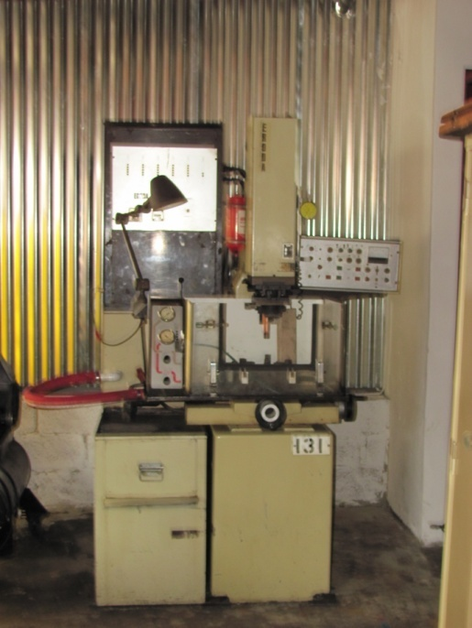

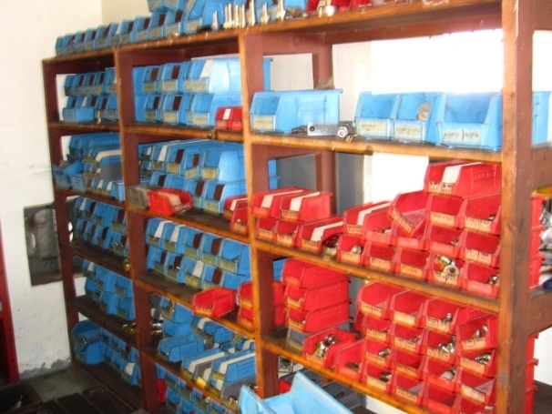
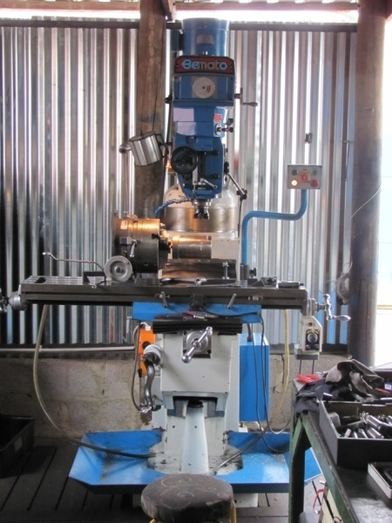
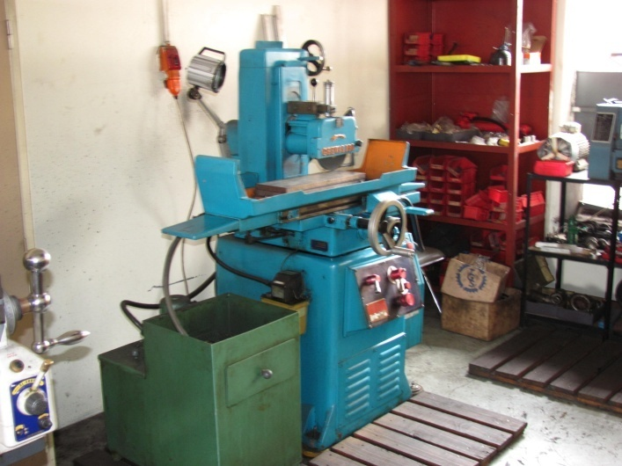
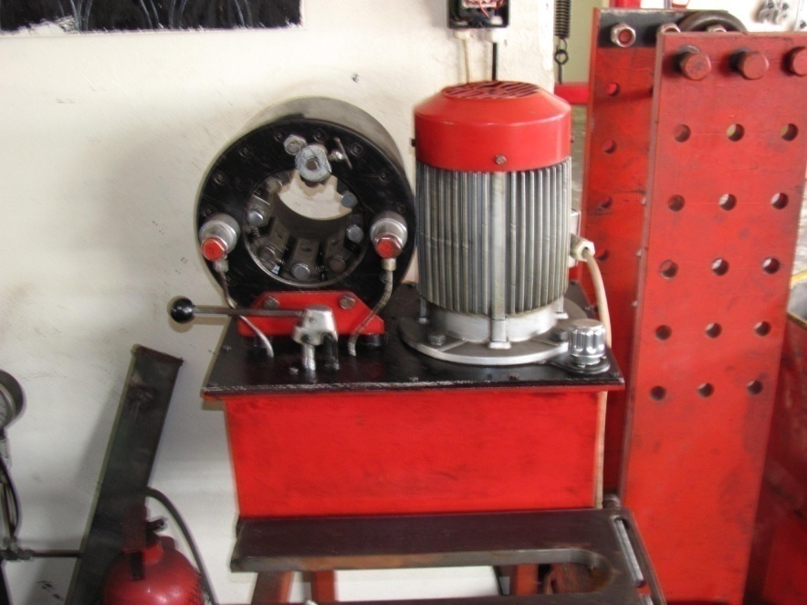
Machinery for production

Slide 19
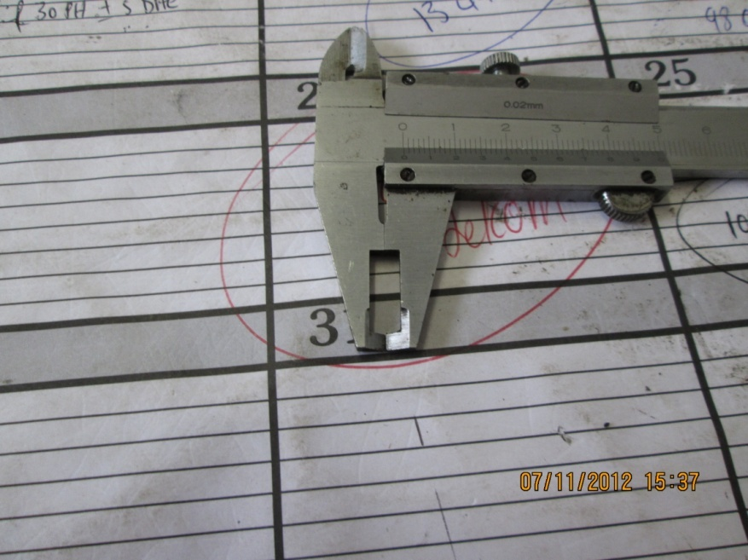
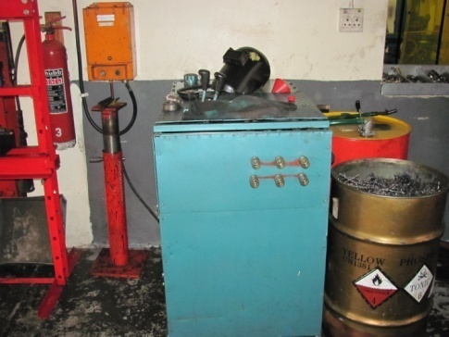
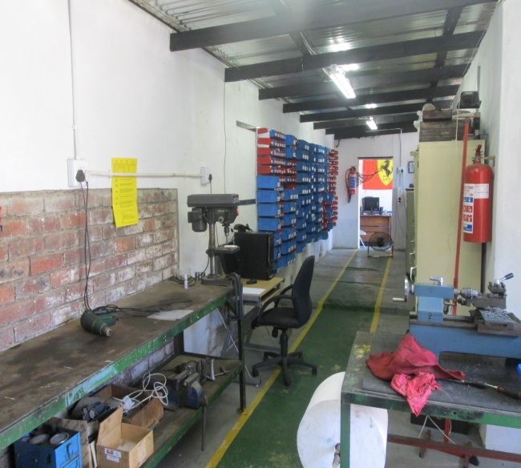
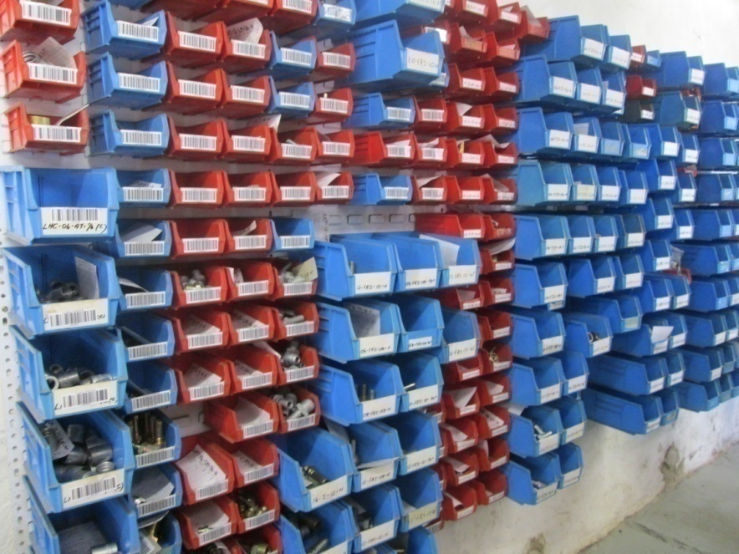
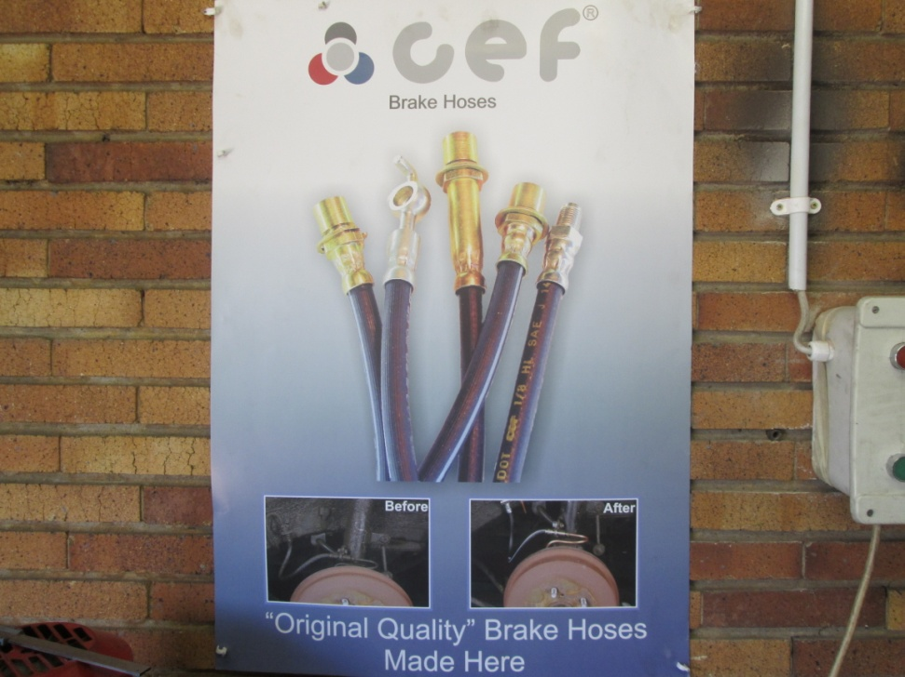
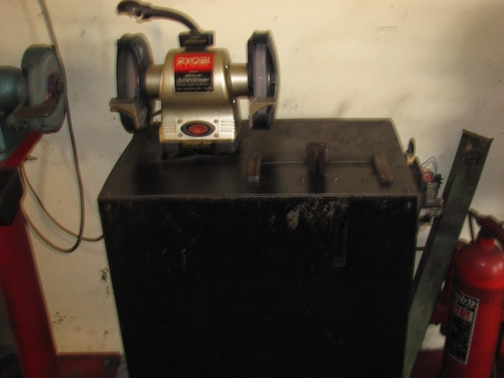
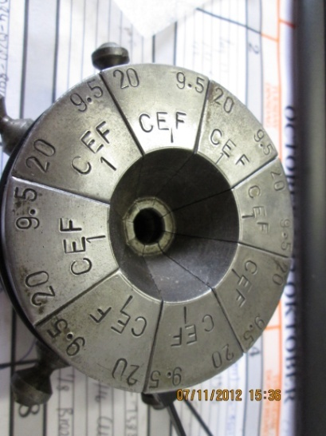

Slide 20
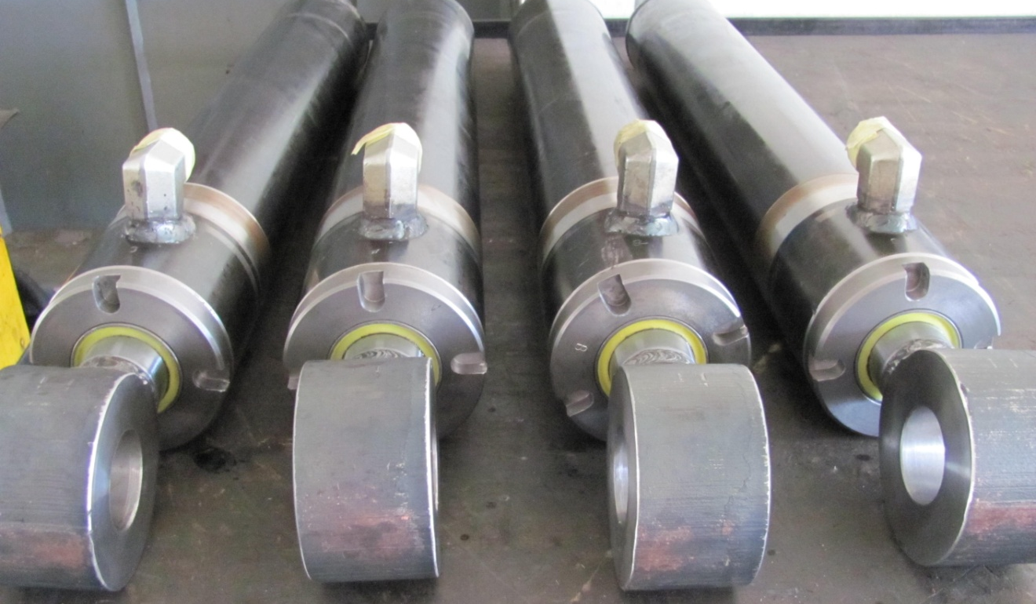
I trust the above will meet your requirements.
We are looking forward to your favourable response, and acceptance of the above proposal, mutually beneficial to all ventures concerned.
Yours Sincerely
Mr. A du Toit
Owner

